Slide 1
2020 Sensing and Intelligent System
TA

Slide 2
Course & TA
Week | Date | Lecture (1-1.5 hr) | Lab (1.5-2hr) | TA
1 | 3/2 | Introduction |  | Lily
2 | 3/9 | Robotics Tools & Technical Writing | 分組 / VirtualBox / Git / Docker | Allen/Andy
3 | 3/16 | Spatial Representations | ROS Tutorial 1 (Command line, topic, tf) | Andy
4 | 3/23 | AprilTag 1, 2, and 3 | ROS Tutorial 2 (Service. Launch, Apriltag) | Lily
5 | 3/30 | Invited Speaker: Peter Yu (CTO at XYZ Robotics) | OpenCV and Depth Sensing (Realsense) | Wolf
6 | 4/6 | 校際活動週 停課一週 | 校際活動週 停課一週
7 | 4/13 | 2D/3D Perception | Calibration ChAruCo | Sean
8 | 4/20 | Motion Planning of Robot Arms | Arm 1 (Dynamixal Pyrobot & Control Locobot, IK, FK) | Jacky
9 | 4/27 | System Integration/Task Planning | Arm 2 (MoveIt!, Simulate in RViz, Yumi) | Jacky, Allen
10 | 5/4 | Problem Formulation & Experiment Design | Smach/actionlib | Lily
11 | 5/11 | Deep Learning & Semantic Segmentation (1) | PyTorch Intro | Ray
12 | 5/18 | Deep Learning & Semantic Segmentation (2) | CNN Classification | Allen
13 | 5/25 | Deep Learning & Semantic Segmentation (3) | Training on Workstation Tutorial / Dataset / Labelme | Andy
14 | 6/1 | Deep Learning & Semantic Segmentation (4) | Semantic Segmentation: FCN / Unet | Alex
15 | 6/8 | Deep Learning & Semantic Segmentation (5) | Grasping or Sim-to-Real (TD3) | Alex
16 | 6/15 | Navigation | PyRobot Navigation (CMP) & Wheel control | Jacky
17 | 6/22 | Final Exams (Open Book)
18 |  | Mini Competition |  | Wolf

Slide 3
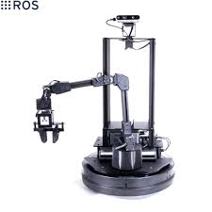
Grading Policy
Hands-on Tutorials: Complete the Tasks and Assignments (40%)
Final Exam: 15 papers (30%)
Mini-Robot Manipulation Challenge & Approach Presentation (30%)
Platform: LoCobot (Pyrobot)
Tasks
Detect and Deliver
Ring Recovery

Slide 4
Account
Github
Google Drive
Slack

Slide 5
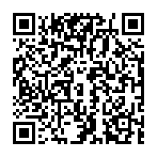
人數篩選
由於本課程會需要一定背景知識與能力要求，且硬體教材數量有限，為保持課程應有之教學水準與學習品質，故學生人數上限為45人。將優先考量學生系所和專業領域作為篩選依據。

